Slide 1

Manafacturing Analysis
Group 4

Slide 2
Participants
Ayush K Sonawane
Renuka Sanbal

Slide 3
Overview of project
This project focuses on analyzing manufacturing data to track production performance, monitor rejection rates, and optimize operational efficiency.
It leverages data visualizations and KPIs to identify trends, department-wise performance, and workforce productivity.

Slide 4
Project Objectives
To monitor key production metrics including Manufactured, Processed, Rejected, and Wastage Quantities.
To analyze rejection patterns by Employee, Machine, and Department.
To identify production trends and resource utilization.
To support decision-making by providing actionable insights through dashboards.

Slide 5
Key Performance Indicators (KPIs)
Total Manufactured Quantity
Total Processed Quantity
Total Rejected Quantity
Wastage Percentage
Employee Wise Rejected Qty
Machine Wise Rejected Qty
Department Wise Manufacturing vs Rejection Ratio
Production Utilization Percentage

Slide 6
Key Insights
Wastage maintained at a low 0.60%, indicating efficient production practices.
75.58% production utilization achieved, with scope for optimizing remaining capacity.
Highest rejection rates identified in specific employees and machines, enabling targeted process improvements.
Department-wise analysis highlighted Woven Labels as a top contributor to both production and rejections, signaling focus areas for quality control.

Slide 7
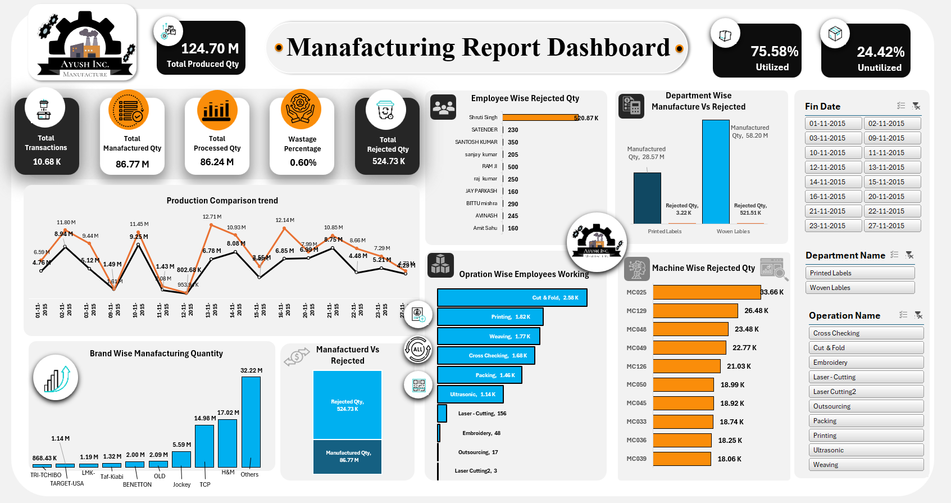
EXCEL DASHBOARD

Slide 8
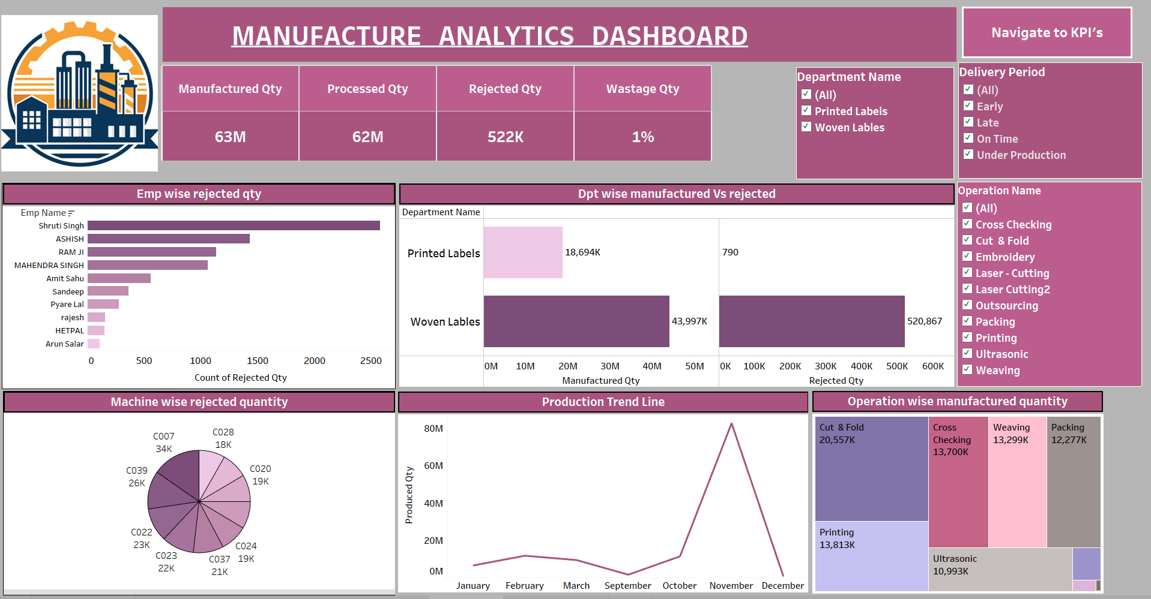

Slide 9
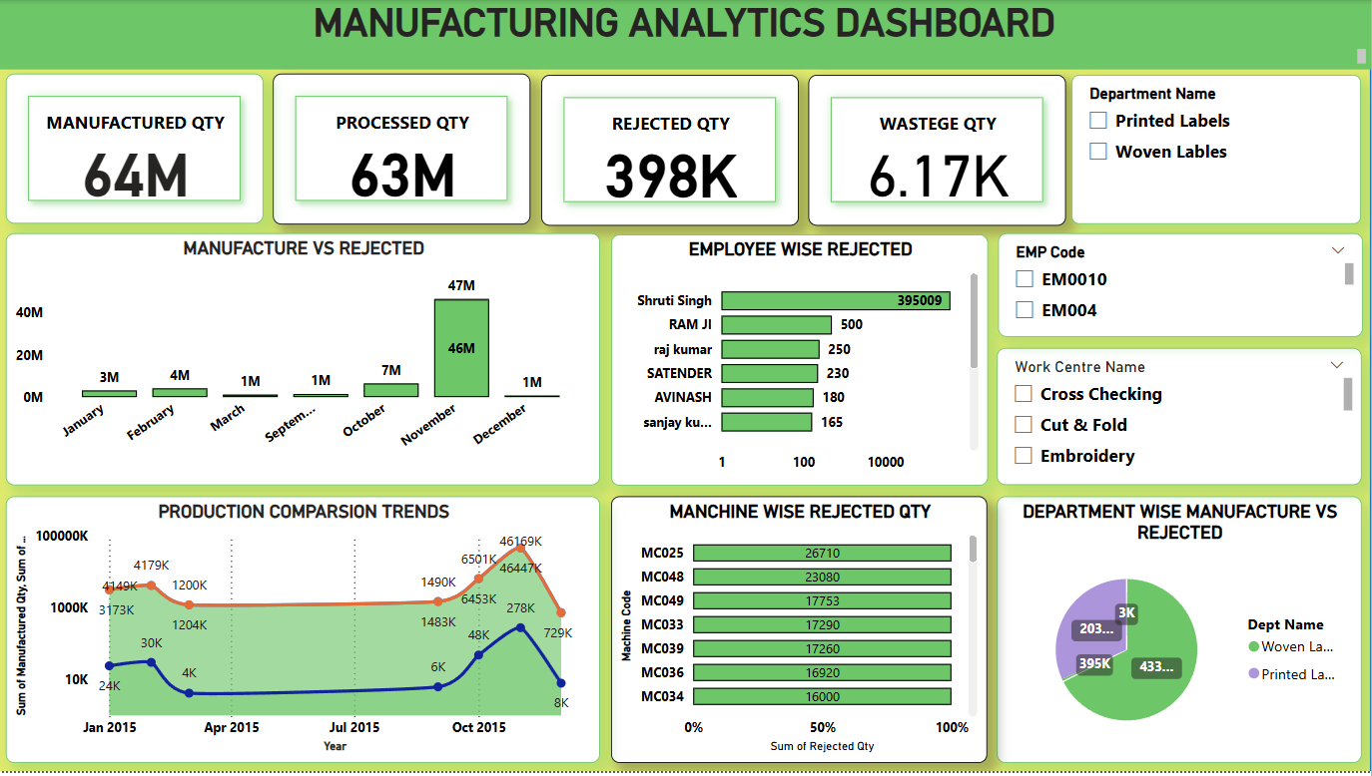

Slide 10
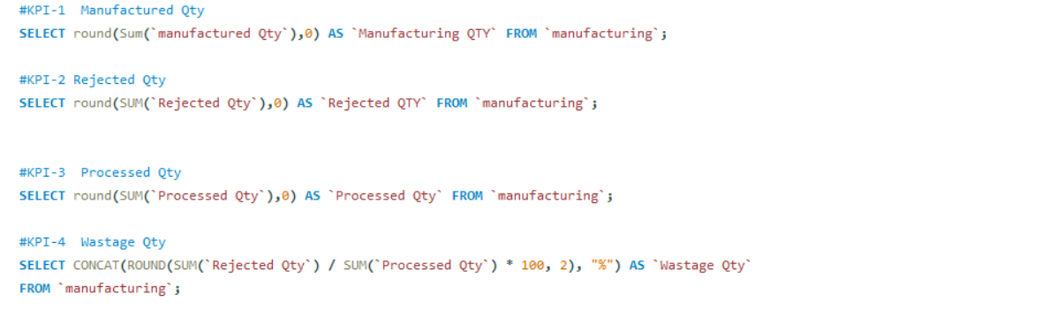
SQL Queries

Slide 11
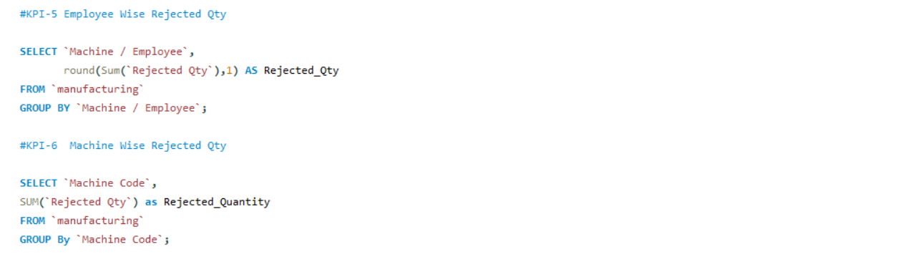
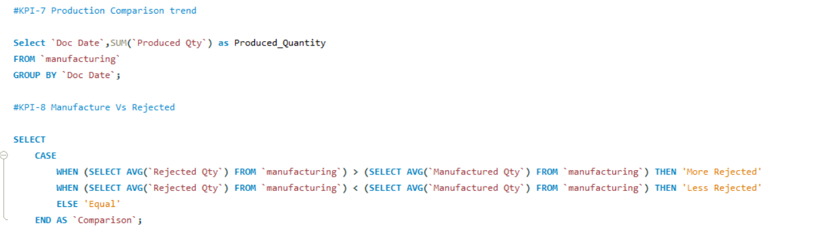

Slide 12
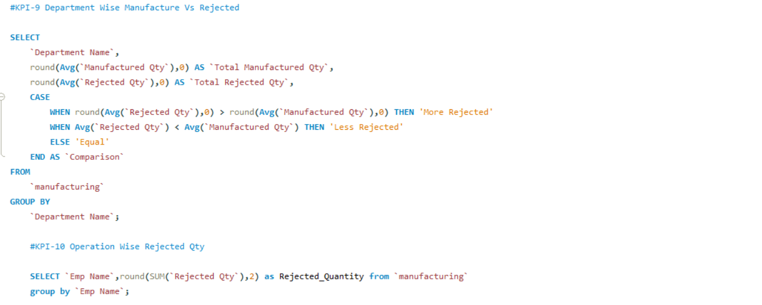

Slide 13

Thank you

